Slide 1
P5 Intro
Mini Minecraft Planner

Slide 2
Mini Minecraft Planner
Given ingredients and a recipe → output crafted item
Planner to write:
Is it possible to create item with given ingredients?
If so, what is the path, i.e. what do you craft first, what do you craft next?

Slide 3
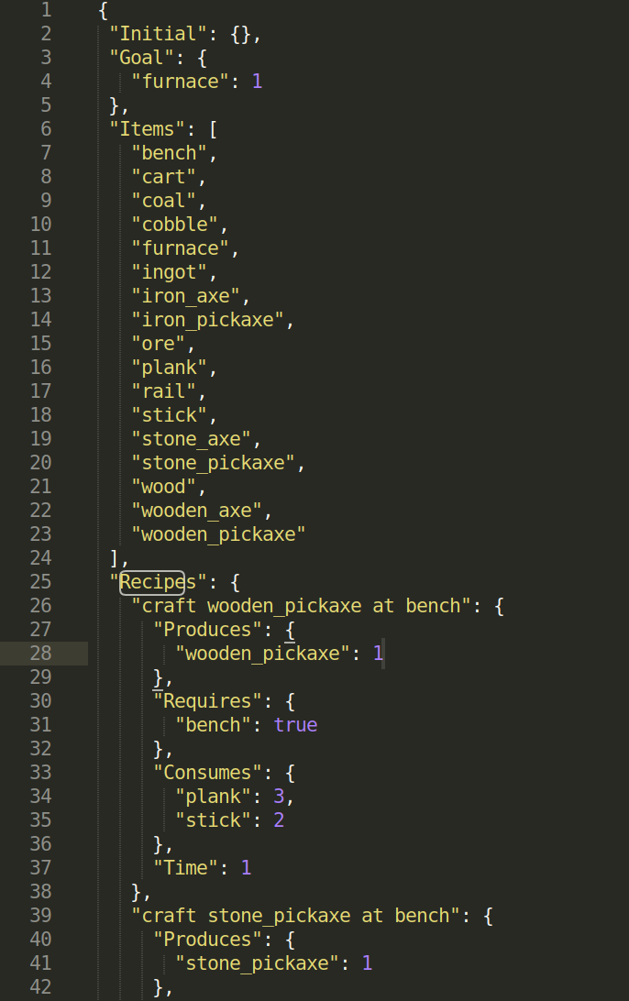
Files in this assignment
Crafting.json
Contains available item types
Contains crafting recipes

Slide 4
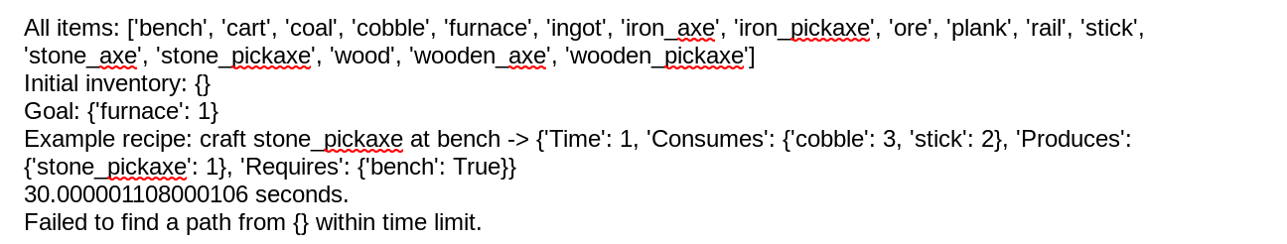
Files in this assignment
Crafting.json
Contains available item types
Contains crafting recipes
Crafting_planner.py
Implement:
make_checker
make_effector
make_goal_checker
heuristic
Search

Slide 5
craft_planner.py
Write these first; all they need to do is translate recipes in crafting.json into runnable functions:
make_checker
make_effector
Check that these functions work individually: does the checker return appropriate True/False for an input? Does the effector return an appropriate next state? It might be helpful to make the effector output a message if the rule can’t be applied (catches errors in checker)
Do make_goal_checker similarly
Implement most of search
Make sure that the code inside your while loop is short and sweet
Write heuristic in a way that fits in with search; finish the rest of search

Slide 6
Note...
Recipe is a namedtuple defined at the top of the .py file.
Recipe = namedtuple('Recipe', ['name', 'check', 'effect', 'cost'])
Similar to pathfinding assignment P1; difference is rather than a provided grid space, you’re in a graph space, and you have to create the graph yourself as you’re searching for the path.
The graph is of states (list of items), which means each node in your graph space should be unique.
Heuristic should be generalizable (although you can assume we only need one of each tool)

Slide 7
Submit
A*-based planner with a heuristic (6 pts)
Should be able to solve all provided test cases within 30 real-world seconds
Ex. Given {}, achieve {'cart': 1, 'rail': 10} [cost=172, len=58]
A written description of 1) your heuristic & 2) any modifications to A* (1 pt)
Heuristic should be generalizable (1 pt)
Your own custom test case (2 pts)
Most difficult goal your planner can solve within 30 real-world seconds
Provide 1) written description & 2) JSON file
(optional extra credit) Write a planner that uses backward-search starting from the goal. (Do the regular forward-search planner before working on EC!)

Slide 8
Questions

